Slide 1

Yield estimation
Solutions
A breaks down in R and S
Isothermal batch reactor
We assume constant density
2) C_{R} = 72 u.a.
C_{R} $CSTR?,\text{C}\text{R} PF?$
3) C_{R} = 63,5 u.a.
3) C_{R} = 54 u.a. (RPAC)
C_{R} = 42 u.a. (Piston)
Indications
The addition of R ou de S does not modify the reaction
So R and S are products et do not interfere in the reaction
We can have A → α R et A → β S or A → α R + β S
The sum of the number of moles of A, R and S is constant
So n_{Ao} = n_{A} + n_{R} + n_{S} or C_{Ao} = C_{A} + C_{R} + C_{S}
The only possibility is then A → R and A → S
Be careful, we don’t know the orders of the reactions!

Slide 2
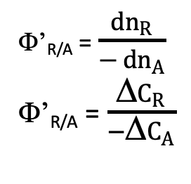
Yield estimation
A → R; A → S
Constant density, C_{A} = C_{Ao} (1-X)
X | 0,05 | 0,15 | 0,25 | 0,35 | 0,45 | 0,55 | 0,65 | 0,75 | 0,85 | 0,95
Φ’_{R/A} | 0,1 | 0,3 | 0,5 | 0,7 | 0,9 | 1 | 1 | 1 | 0,9 | 0,7
Φ’_{R/A}
Φ’_{R/A} = $\frac{dn_{R}}{− dn_{A}}$
Φ’_{R/A} = $\frac{\text{D}C_{R}}{−\text{D}C_{A}}$
X

Slide 3
Yield estimation
X = 0,9
Φ’_{R/A} = 0,8
Y_{R/A} = X Φ’_{R/A} = 0,72
C_{R} = 72 u.a.
A → R; A → S
Continuous stirred tank reactor
Objective: C_{A} = 10 u.a. soit X = 0,9
Φ’_{R/A}
C_{Ao} = 70, C_{A} = 10, X = 0,857
Φ’_{R/A} = 0,9
Y_{R/A} = X Φ’_{R/A} = 0,771
C_{R} = 54 u.a.
X

Slide 4
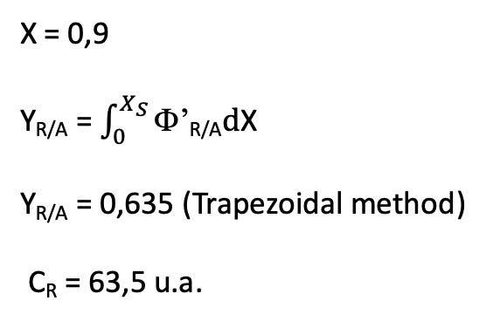
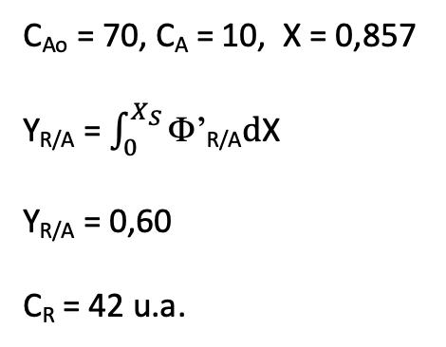
Yield estimation
X = 0,9
Y_{R/A} = $\int_{0}^{X_{S}}{\text{F}\text{’}\text{R}\text{/}\text{A}\text{d}\text{X}}$
Y_{R/A} = 0,635 (Trapezoidal method)
C_{R} = 63,5 u.a.
A → R; A → S
Plug flow
Φ’_{R/A}
C_{Ao} = 70, C_{A} = 10, X = 0,857
Y_{R/A} = $\int_{0}^{X_{S}}{\text{F}\text{’}\text{R}\text{/}\text{A}\text{d}\text{X}}$
Y_{R/A} = 0,60
C_{R} = 42 u.a.
X

